Slide 1
Trees - traversals

Slide 2
DFS iterative

Slide 3
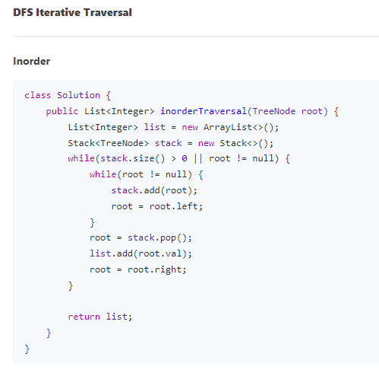

Slide 4
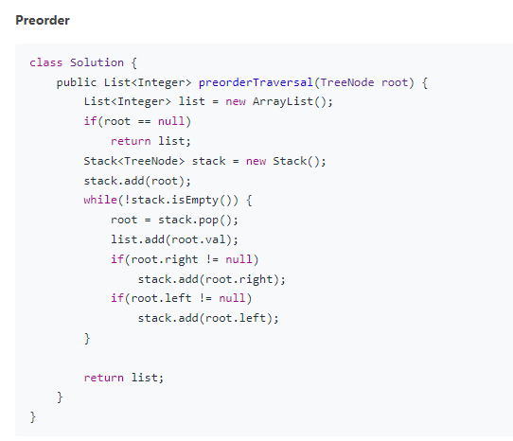
Preorder traversal

Slide 5
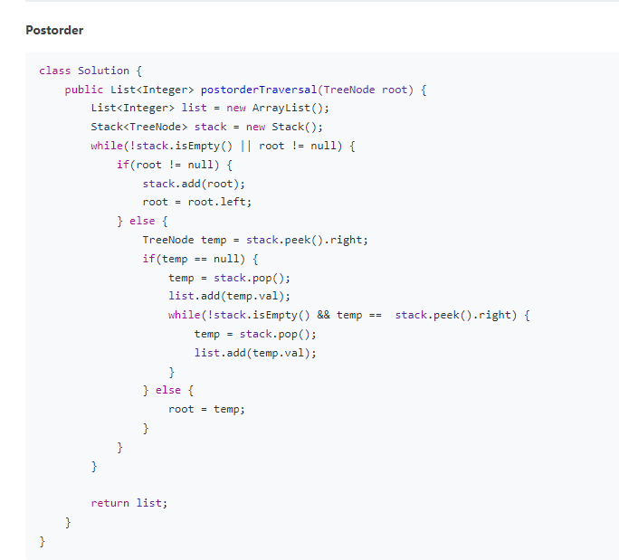

Slide 6
DFS recursive

Slide 7
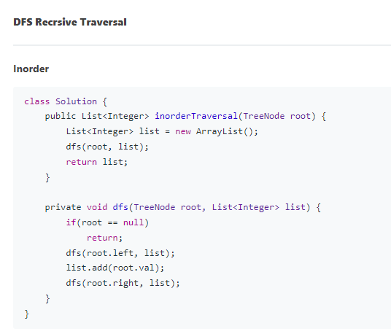

Slide 8
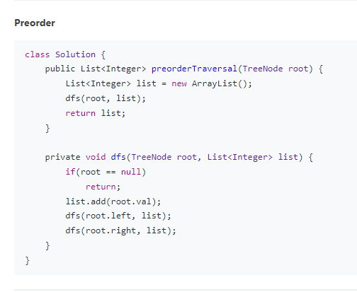

Slide 9
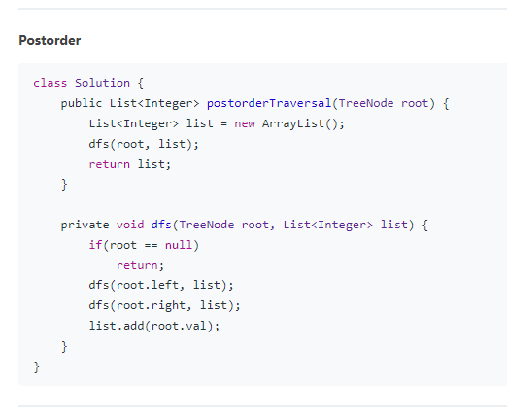

Slide 10
Other traversals

Slide 11
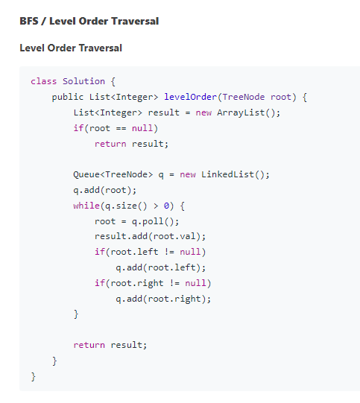

Slide 12
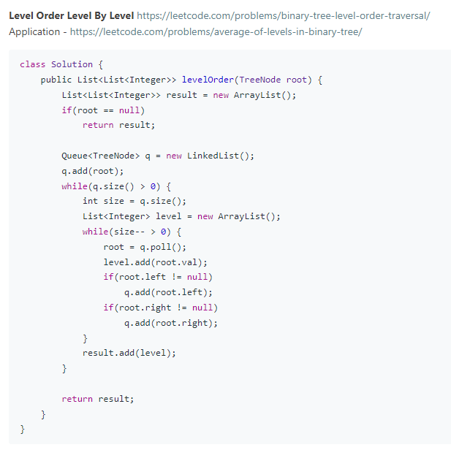

Slide 13
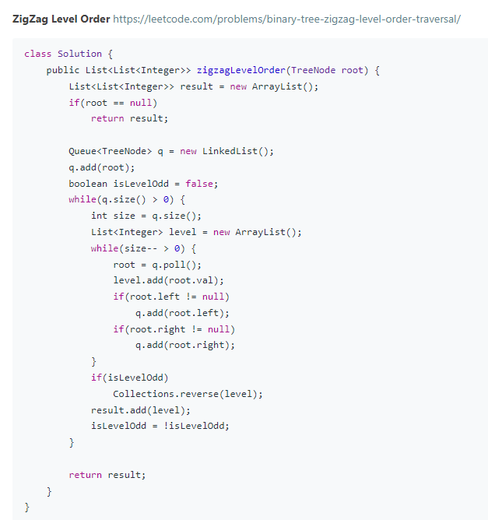

Slide 14
Leetcode articles
https://leetcode.com/discuss/general-discussion/937307/iterative-recursive-dfs-bfs-tree-traversal-in-pre-post-levelorder-views
https://leetcode.com/discuss/study-guide/1212004/binary-trees-study-guide

